Slide 1


Classification Modeling to Predict and Reduce Employee Attrition
By Nicholas Bronson

Slide 2

Agenda
01 Problem & Key Questions
02 Methodology
03 Results
04 Conclusions & Recommendations
05 Next Steps
Agenda

Slide 3

Problem:
Employee attrition has increased dramatically at MTS
Key Questions:
Who are the employees that are most likely to resign?
What factors have the largest influence of whether employees leave?
What might appropriate and effective interventions look like, and what aspects might they target?
01
Problem &
Key Questions
Notes:
U.S. Bureau of Labor Statistics announced that 4.3 million Americans, or 2.9% of the entire workforce, quit their jobs in August

Slide 4
Problem scoping, determination of performance metrics
Data exploration
Initial insights
First Steps
02
Testing and
Tuning
Modeling & Selection
Model tuning and optimization
Methodology
Results and
Conclusions
Conclusions and recommendations
Outline for next steps

Slide 5

The Case for Classification & Key Metrics
A classification model is well suited for MTS’s problem as it allows us to group employees and perform interventions on specific employees who are at high risk of leaving.
Notes:
False positives are not all that costly as performing an intervention on employees who might not be seeking to leave could be , while false negatives could result in overlook employees that are highly likely to leave which has a large cost

Slide 6
The Case for Classification & Key Metrics
A classification model is well suited for MTS’s problem as it allows us to group employees and perform interventions on specific employees who are at high risk of leaving.
Key Metrics
Recall - It is important to correctly identify employees that are likely to leave
Accuracy - This is secondary, however, the model should be able to segment as well as possible once recall is optimized
Notes:
False positives are not all that costly as performing an intervention on employees who might not be seeking to leave could be , while false negatives could result in overlook employees that are highly likely to leave which has a large cost
We are not quite as concerned about precision, we are not necessarily aiming to

Slide 7
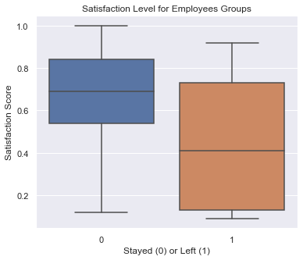
Initial Exploration
Roughly 76% of the employees in the dataset remain at MTS
Satisfaction levels are higher on average for employees who stayed versus those who left
Only 6.6% of employees in the high-salary band have left the company
There appears to be a relationship between high working hours and low satisfaction scores

Slide 8
Models tested included: K-NN, Logistic Regression, Decision Tree, Random Forest
Feature engineering and optimization Included: creation of dummy variables, testing dummy variables vs. numeric substitution
03
Strong Performance Following Optimization
Random Forest:
Recall: 97.3%
Accuracy: 98.2%
Decision Tree
Recall: 96.7%
Accuracy: 97.9%
K-Nearest Neighbors (N=9)
Recall: 92.7%
Accuracy: 93.9%
Weaker Performance even after Optimization
Logistic Regression:
Recall: 82.6%
Accuracy: 71.8%
Results

Slide 9
Models tested included: K-NN, Logistic Regression, Decision Tree, Random Forest
Feature engineering and optimization Included: creation of dummy variables, testing dummy variables vs. numeric substitution
03
Strong Performance Following Optimization
Random Forest:
Recall: 97.3%
Accuracy: 98.2%
Decision Tree
Recall: 96.7%
Accuracy: 97.9%
K-Nearest Neighbors (N=9)
Recall: 92.7%
Accuracy: 93.9%
Weaker Performance even after Optimization
Logistic Regression:
Recall: 82.6%
Accuracy: 71.8%
Results

Slide 10

Feature Importance
A random forest regressor assisted in determining the following factors have the most influence on attrition:
Satisfaction level
Recency of last evaluation
Number of projects
Average monthly hours
Time spent with the company

Slide 11
04 Conclusions & Recommendations
Conclusions:
Our model can be used now and perhaps again in several months to classify employees as those likely to leave and those likely to stay
Satisfaction, time spent with the company, and working hours a month are features influencing employee retention
An intervention might target specific employees, those misclassified as employees who would leave, and those who are classified as so in the future
Recommendations:
Roll out an intervention targeted at identified employees
Perhaps consider adjusting policies around working hours, and incentives/recognition for longstanding employees company-wide
Inquire about and address employee satisfaction levels, create a feedback loop

Slide 12
05 Next Steps
Gather additional data, re-train models continuously
More specific salary information, remote vs. in-person,
Additional Ensembling and feature engineering
Explore Gradient Boosted Tree Models
Measure efficacy of intervention methods, adjust as necessary

Slide 13

THANK YOU

Slide 14
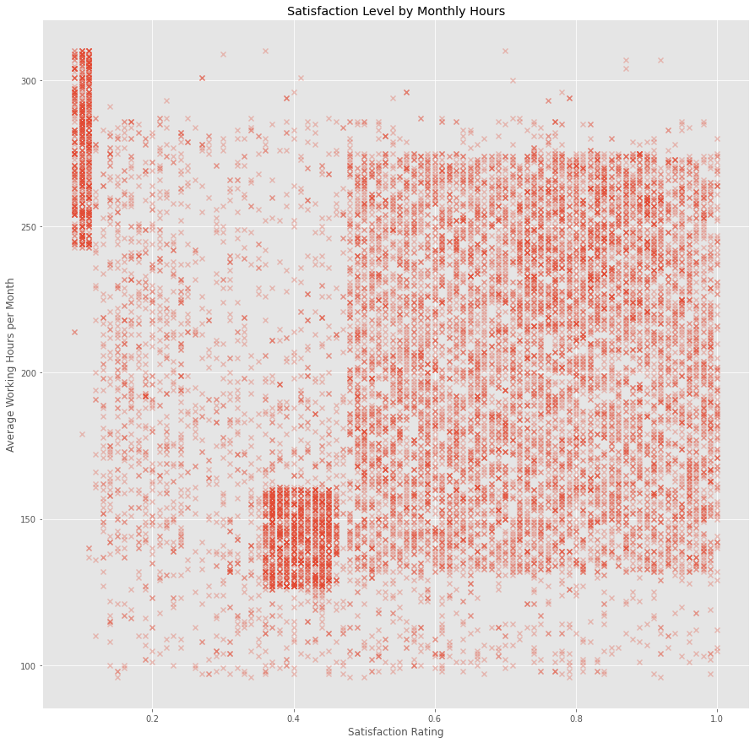
Appendix

Slide 15
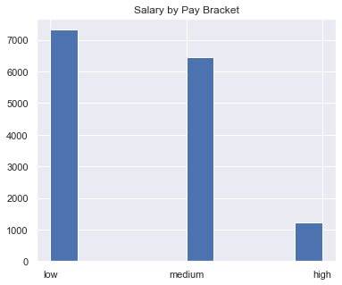
Appendix

